Slide 2

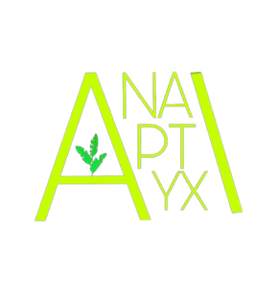



Slide 3

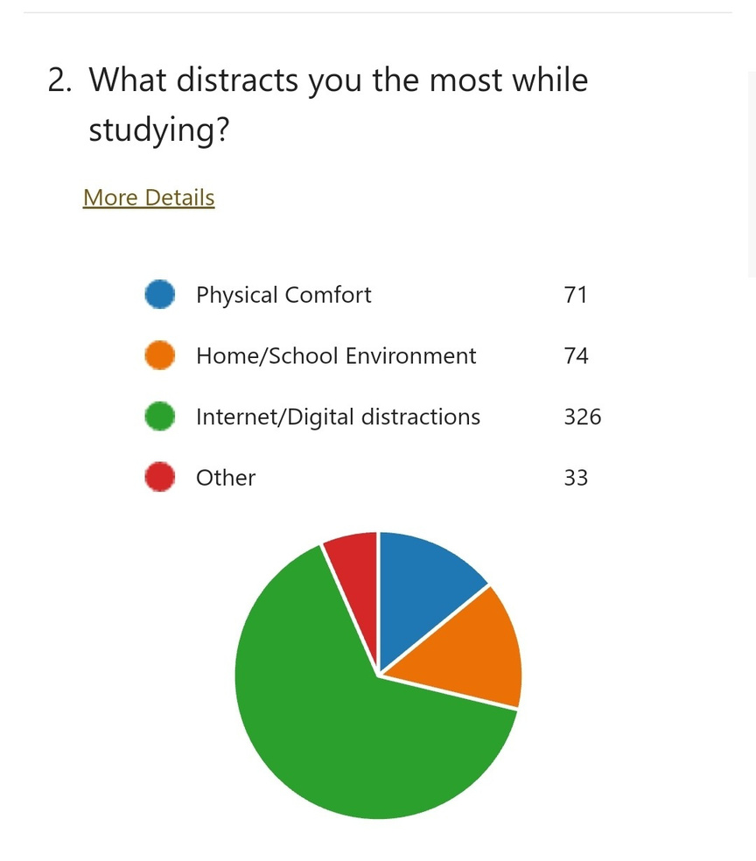



Attention Span Statistics

Slide 4
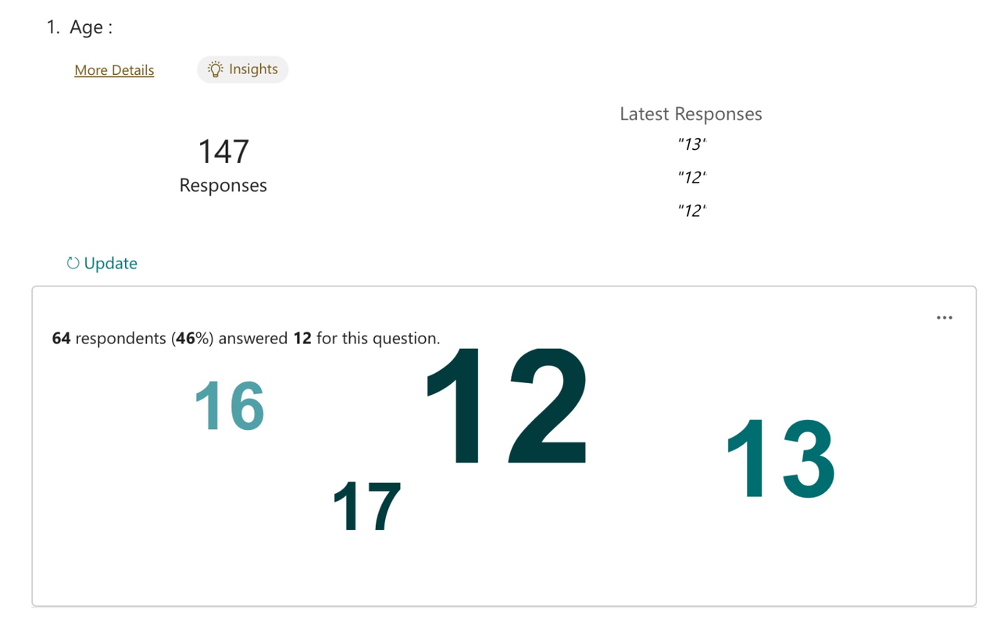
Attention Span Statistics
Age of students

Slide 5
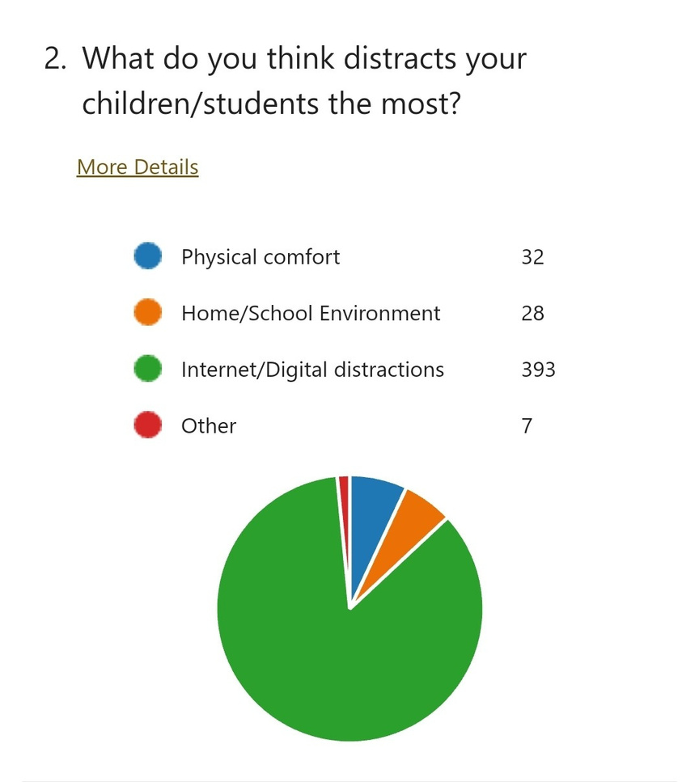
Attention Span Statistics

Slide 6
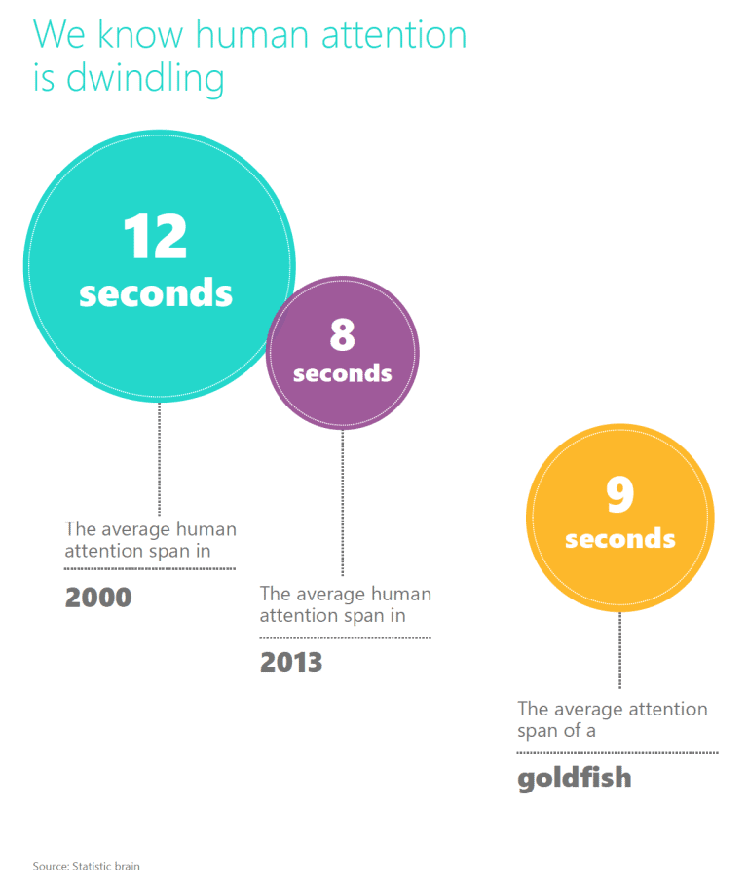

Attention Span Statistics

Slide 7



About Us
At Anaptyxi, we have developed an innovative solution that integrates AI into the education sector to help students maintain focus on their tasks while simultaneously aiding teachers in creating engaging lessons.

Slide 8



Our AI Model
FocusMate

Slide 9


Alignment with SDG 4

Slide 10
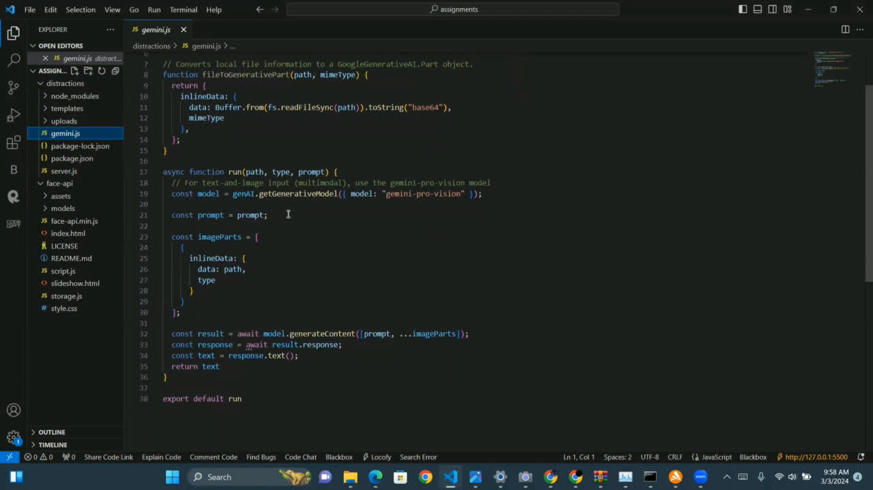

Slide 11

Thank You

